Slide 1

教学辅助课件
牛津 七年级下

Slide 2


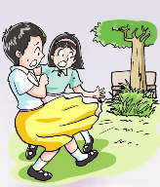

The _____ in the park
Unit 5 Amazing things
ghost
Reading

Slide 3



Words & phrases review
as
usual
as usual
sit down
suddenly
whisper
bush
turn around
adv. 和……一样
adj. 通常的，平常的
照例；像往常一样
坐下
adv. 突然
n. 低语，耳语
n. 灌木丛
转身；（使）翻转
Read after the tape and speak out the Chinese immediately.

Slide 4
Words & phrases review
anybody
nobody
reply
strange
leave
quickly
on one’s/the way
happen
pron. 任何人
pron. 没有人，无人
vi. 答复，回答
adj. 奇怪的；陌生的
vt. 离开
adv. 迅速地，飞快地
在……路上
vi. 发生

Slide 5
Words & phrases review
everything
wonder
carefully
search
himself
say to oneself
pron. 每件事，每样事物，
一切
vi. & vt. 琢磨，想知道；
感到诧异
adv. 仔细地，认真地；
小心地
vt. & vi. 搜查，搜寻，搜索
pron. 他自己
自言自语

Slide 6
Words & phrases review
weak
miaow
pick
pick up
surprised
later
run away
somebody
adj. 虚弱的，无力的
vi. （猫叫声）喵
vt. 拾起
拿起，举起
adj. 吃惊的，惊讶的
adv. 随后，后来
逃离，跑开
pron. 某人，有人

Slide 7
Here are some words in the story about the “ghost” in the park. Find the meaning of each word by circling the correct letter.
(P 59)
B1
1. As usual means _____.
a the first time b as they often do
c seldom
2. To reply means _____.
a to think b to say something again
c to say or write something as an answer
3. To leave means _____.
a to find out b to look for
c to go away

Slide 8
4. If you wonder, you _____.
a want to know something
b feel great
c say something happily
5. To search means _____.
a to find something
b to shout at something
c to look carefully for something
6. Weak means _____.
a clever b small
c not strong

Slide 9

Objectives
To read Daniel’s blog and learn about Amy and Millie’s story in the park
To learn how to retell the story to others
To learn the new words and useful expressions

Slide 10

Focus on
Words:
suddenly usual whisper bush anybody nobody reply strange everything leave quickly happen wonder carefully search himself weak pick surprised later somebody as
Expressions:
as usual turn around take … to
on one’s/the way say to oneself pick up
sit down run away

Slide 11

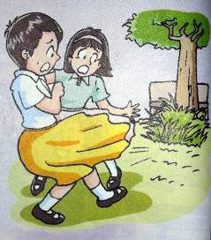
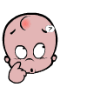
Last Sunday, Millie and Amy went to Sunshine Park. Look at the picture and the title, guess what happened.
The ghost in the park
They saw something terrible?
They heard something strange?
Read the story and answer the following questions.

Slide 12
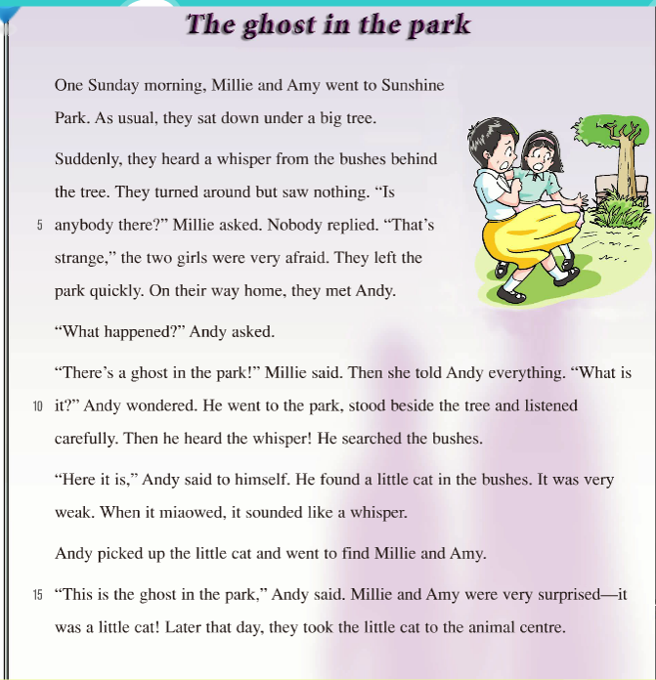
It came from the bushes behind the tree.
1. Where did the whisper come from?
2. What was the ghost?
1
2
The ghost was a little cat.

Slide 13

4
7
1
2
3
6
5
a We ran away quickly.
b Andy found a little cat in the bushes.
c We sat under a big tree in the park.
d Suddenly, we heard a whisper.
e We turned around but saw nothing.
f Andy went to the park.
g I told Andy about the strange sound.
Millie wrote some sentences about what happened, but they are not in the correct order. Help her put the sentences in the correct order. (P 59)
B2

Slide 14




Millie is telling her friend Wendy on the phone about what happened in the park, but Wendy cannot hear her clearly. Choose T or F. (P 60)
B3
1. I was afraid when I heard the whisper.
2. The whisper came from a big tree.
3. We went back to the park with Andy.
4. Somebody helped Andy find the
“ghost”.
5. Andy found a little cat in the bushes.
6. Andy gave the little cat to Amy.
the bushes behind the tree.
didn’t go back
Nobody
the animal centre.

Slide 15
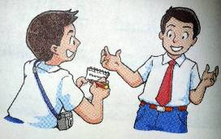
Henry: What did Millie and Amy hear?
Andy: They heard a _______. They were
very _____ and left the park quickly.
Henry: What did you find?
Andy: I found a little cat in the ______.
Henry: Why did the little cat sound like a
ghost?
Andy: It was very _____, so when it
________, it sounded like a whisper.
Henry: Where’s the little cat now?
Andy: We took it to the _______ centre.
whisper
afraid
Henry, Andy’s friend, is asking Andy about the “ghost”. Help Andy answer his questions. (P 60)
B4
bushes
weak
miaowed
animal

Slide 16
Pay attention to the underlined expressions.

Slide 17
Translate the following phrases.
①照常；像往常一样
②转身
③在他们回家的路上
④自言自语
⑤捡起
⑥把……带到……
as usual
turn around
on their way home
say to himself
pick up
take…to…

Slide 18
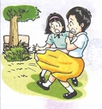
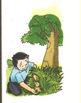
WHEN
One Sunday morning
_________________
WHERE
_____________
Sunshine Park
Fill in the blanks, then retell the story.
The ghost in
the park
WHO
___________________
Millie, Amy and Andy
Millie and Amy heard a_______. They were very ______ and left the park.
2. They met Andy. Andy found _________ in the bushes. They sent it to_________________.
whisper
afraid
WHAT
a little cat
the animal centre

Slide 19
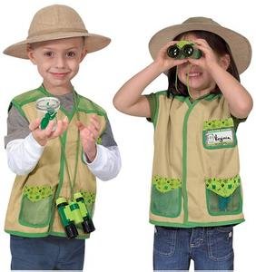
Pair work
Andy是一个既勇敢又乐于助人的学生，假设你是校报小记者，请你就此事对Andy进行一次采访。
Examples:
Reporter: When did Millie and Amy go to Sunshine Park?
Andy: ____________________
Reporter: What did they hear?
Andy: ___________________________.
…
1. Were they afraid?
2. What did they tell you?
3. What did you find?
4. Who made the sound?
5. Why did the little cat sound like a ghost?

Slide 20
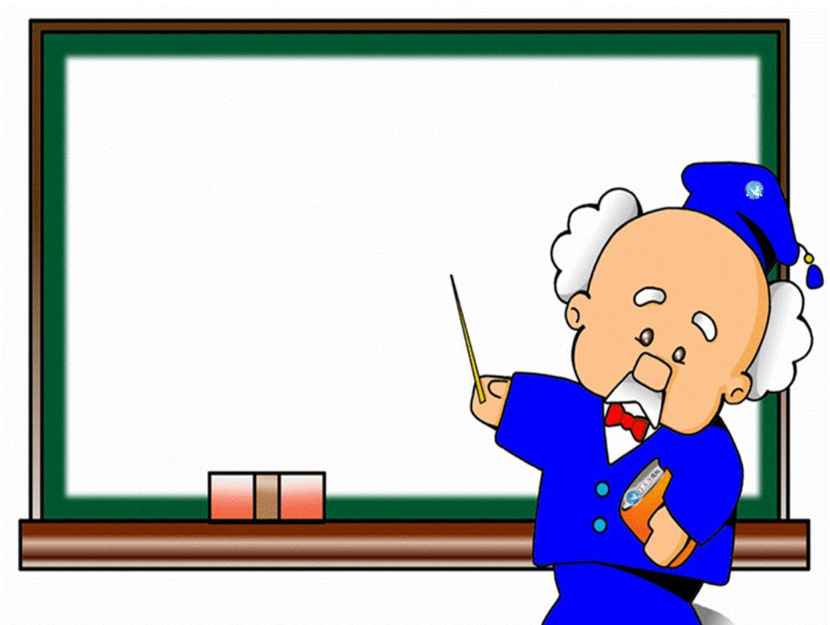
Language points

Slide 21
1. As usual, they sat down under a big tree.
as usual意为“像往常一样；照例”，可以放句首也可放句末。
①He worked hard as usual.
他像往常一样辛勤工作。
②As usual, there weren't many people at the meeting.
像往常一样，来开会的人不多。
③Things are as usual.
一切像往常一样。

Slide 22
2. They turned around but saw nothing.
turn around 意为“转身”，指身体转向和原来方向相反的位置。
①Sit still and don't turn around.
坐着别动，不要转过身来。
②Don’t turn around in class.
在课堂上别回头。
③I turned around quickly to see if anyone was following me.
我很快的转过身查看是否有人跟踪我。

Slide 23
3. On their way home, they met Andy.
on one’s/the way to … 意为“在(某人)去……的路上”，后跟地点名词；
当地点为副词home, here, there等时，要省略to。
①On her way to school, she met her friend.
在去学校的路上，她遇到了她的朋友。
②On the way home, we picked our wedding date.
回家的路上，我们选好了结婚的日子。

Slide 24
4. “Here it is,” Andy said to himself.
say to oneself 自言自语
oneself是反身代词，意为“某人自己”。它的具体形式为:
myself 我自己 yourself 你自己
herself 她自己 ourselves 我们自己
themselves 他们自己
yourselves 你们自己
用括号内所给单词的正确形式填空。
①Jim said to______ (he), “Why am I here?”
②I kept saying to ______(I) that this wasn’t really happening.
himself
myself

Slide 25



Slide 26
Ⅰ根据括号内所给的汉语提示完成句子。
1. Zhang Hua put the book on his desk and then ______(离开) the classroom.
2. — Jack, what are you thinking about?
— I’m___________(琢磨) where to go for a trip this weekend.
3. — Why do you look so unhappy, Bob?
— I can’t find my watch. I put it here five minutes ago. How _______(奇怪)!
4. I was walking in the street yesterday. ___________(突然), a little boy knocked into me.
5. — Lucy didn’t come to school this morning. What _____________(发生) to her?
— She was ill in hospital.
left
wondering
strange
Suddenly
happened

Slide 27
Ⅱ根据汉语提示，完成下面的句子。每空词数不限。
1. 像往常一样，李梅上了公共汽车后，在后面坐了下来。
____________, Li Mei __________at the back after she got on the bus.
2. 这个老人经常在他的卧室里自言自语。
The old man often ______________in his bedroom.
3. 那个男孩从地上捡起一个石头，快速跑开了。
The boy ____________a stone from the ground and __________________.
4. 昨天，在我上学途中，我遇到了我的一个老朋友。
Yesterday, ____________school, I ______an old friend of mine.
5. 王小姐听到从灌木丛传来一声低语，于是她转过身去。
Miss Wang _______________from the bushes, so she ________________.
As usual
sat down
says to himself
picked up
ran away quickly
on my way to
met
heard a whisper
turned around

Slide 28
Homework
1. Learn the new words and expressions
by heart after class.
2. Read the articles on page 1 of
Learning English. The more you read,
the faster and better you’ll understand.
3. Write an article about some strange things you know.
4. Preview Grammar on pages 61-62.

